Slide 1
Communication 2.0. Tool for efficiency and motivation
Dr. psych Egita Gritane

Slide 2
What is communication?
Socio-economical environment - country
Organizational culture
Leadership
Attitudes and Actions
Language and Message

Slide 3
Layouts of communication
Postures, face and gestures
Words
Meanings
Intonation
Linguistic structures used
Purpose
Inner attitudes and believes

Slide 4
What purpose communications are having ?
Share
Agree/disagree on common goal
Inform
Engage
Express
Reflect
Learn

Slide 5
Organizations - engagement
Inspiration
Satisfaction
Active involvement
Recognition
Sharing
Shifts of activity and relaxation
Safety
Clear rules

Slide 6
Social identity – social self
Social identity forms:
Attitudes
Norms
Behaviors
Values

Slide 7
When social identities meet
It influences perception of individual from other group

Slide 8
When social identities meet

Slide 9
Ego roles
Role of
parents
Role of
parents
Adult’s
role
Adult’s
role
Child
role
Child
role

Slide 10
Types of conflicts- external conflicts
Situation
Situation
Personality
Personality
Values
Values

Slide 11
Strategies of conflict solutions
☺
Competition
Co-operation
Mutual
aims
Compromise
Avoidance
Adaptation
☹
Mutual relationships
☺

Slide 12
Power
Power is primarily dimension of relationships and wider social field
People with power have greater access to resources and control over division of these resources

Slide 13
Power
Subjective feeling of power dominates and guides behavior
Feeling of power vs. feeling of dependence
Search for opportunities
Risk avoidance

Slide 14
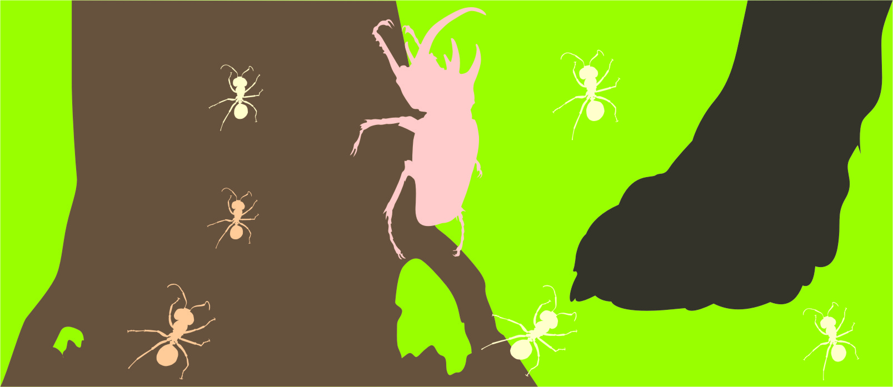
Result in performance

Slide 15
Social influence- Evaluation
Critics
Constructive
Concrete and specific
Timeliness
Wish / recommendation

Slide 16
Social influence- Evaluation
Recognition
Validity
Concreteness
Timeliness
Evaluation instead of manipulation
For done, not potential
Positive amplification

Slide 17
Mature love state – which one ?
1
2
3
4
5

Slide 18
Once again - Personal integrity
Inspiration
Active involvement
Recognition
Satisfaction
Sharing
Clear rules
Safety
Shifts of activity and relaxation

Slide 19
Communication – trap or possibility
The process of cognitive shifting - using communication to retarget attention and form common identity with team
Inner speech
Verbal speech/Non-verbal
Attitudes/Behavior

Slide 20
Intangible aspect of business
IBM Example

Slide 21
How could a company that stands among the most cash-rich in the world, the onetime icon of cool that broke IBM’s iron grip on the computer industry, have stumbled so badly in a race it was winning?
Kurt Eichenwald

Slide 22
Lean competition machine led by young visionaries of unparalleled talent Transformed into bureaucracy-laden, with an internal culture that unintentionally rewards managers who strangle innovative ideas that might threaten the established order of things.

Slide 23
Rejection of innovation

Slide 24
By 1998 a prototype of the revolutionary tool e-book was ready to go.
Thrilled with its success and anticipating accolades, the technology group sent the device to Bill Gates
who promptly gave it a thumbs-down. The e-book wasn’t right for Microsoft, he declared.

Slide 25
1999
The group working on the initiative was removed from a reporting line to Gates and folded into the major-product group dedicated to software for Office, the other mammoth Microsoft moneymaker besides Windows.
Immediately, the technology unit was reclassified from one charged with dreaming up and producing new ideas to one required to report profits and losses right away.

Slide 26
The death of the e-book effort was not simply the consequence of a desire for immediate profits.
The real problem was that a simple touch-screen device was seen as a laughable distraction from the tried-and-true ways of dealing with data.
“Office is designed to inputting with a keyboard, not a stylus or a finger,” the official said. “There were all kinds of personal prejudices at work.”

Slide 27
Perceived injustice

Slide 28
2000
A businessman with a background in deal-making, finance, and product marketing had replaced a software-and-technological genius.
Stock value falls

Slide 29
2003
The older employees had millions, and the younger ones couldn’t have towels?
Cuts in costs

Slide 30
Consequences for organizational culture

Slide 31
The strategy for success at Microsoft was turned on its head
People turned into people trying to move up the ladder, rather than people trying to make a big contribution to the firm

Slide 32
Right communication
Helps companies improve the interpersonal relationships between its
workers – who may even come to
realize that work can actually be rewarding and satisfying beyond the
paycheck

Slide 33
For that managers have to pay attention on most valuable tool - communication
Take a look at the company from different angles – finance, product, structure BUT also communication and values
Companies live on different stages of development.
No ready-made solutions.

Slide 34
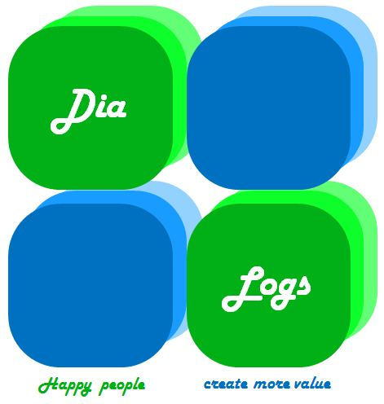
Egita Gritane DR. PSYCH / MANAGING DIRECTOR
egita.gritane@dialogs.eu
Mob. +371 29462529

